Slide 1
DataModel: CAD Integration
Office Integration
Still integrates to
standard ItemType
„Document“
Document
File
XRef
Part
ARAS dictated properties
item_number
name
description
viewable_2d_file (type: item – link to image file
Viewable_3d_file (type: item – linke to neutral 3D)
BOM
CAD Document
Simple LifeCycle with
Permissions to promote manually
Preliminary → Review → Released
Number Sequence on property „item_number“
will be generated by the server-side Method.
„Generate CAD Doc Number“
On Event:
„OnAfterAdd“
Structure
Classifications:
Assembly
Drawing
Standard Part
XPLM CAX Connector
– Methods & Actions

Slide 2


CAD Integration
Separate Identity „CAD Integration“
for CAD Intergration users
CAD
Doc A
CAD
AssyFile
CAD user
=
ARAS user
viewable
CAD
Doc 1
CAD
PartFile
Save to
PLM
viewable
CAD
Doc 2
CAD
PartFile
Load to
CAD
viewable
CAD
Doc 3
CAD
PartFile
viewable
CAD Document Structure
behaviour:
„hard Fixed“
Slide <number>

Slide 3
Derived BOM from CAD Integration
Relationships from CAD Document to Part
Separate ItemType „CAD Document“
1
CAD
Doc A
CAD
AssyFile
BOM
CAD user
=
ARAS user
viewable
CAD
Doc 1
CAD
PartFile
Save to
PLM
Part 1
viewable
Part 2
CAD
Doc 2
CAD
PartFile
Load to
CAD
Part 123
viewable
CAD
Doc 3
CAD
PartFile
viewable
Part BOM
behaviour:
„Float“
CAD Document Structure
behaviour:
„hard Fixed“
Slide <number>

Slide 4
Links from Part to CAD
CAD
Doc A
CAD
AssyFile
BOM
CAD user
=
ARAS user
viewable
CAD
Doc 1
CAD
PartFile
Save to
PLM
Part 1
viewable
Part 2
CAD
Doc 2
CAD
PartFile
Load to
CAD
Part 123
viewable
Item property
CAD
Doc 3
CAD
PartFile
viewable
Slide <number>

Slide 5
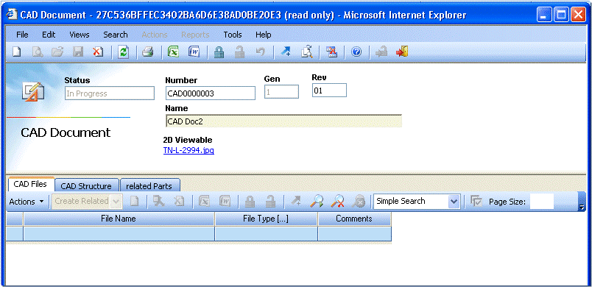

Slide 6

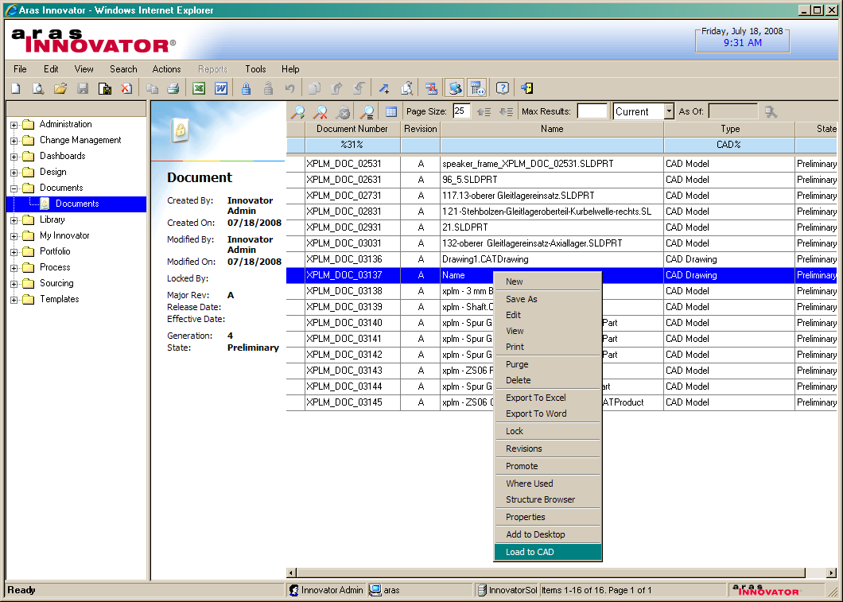
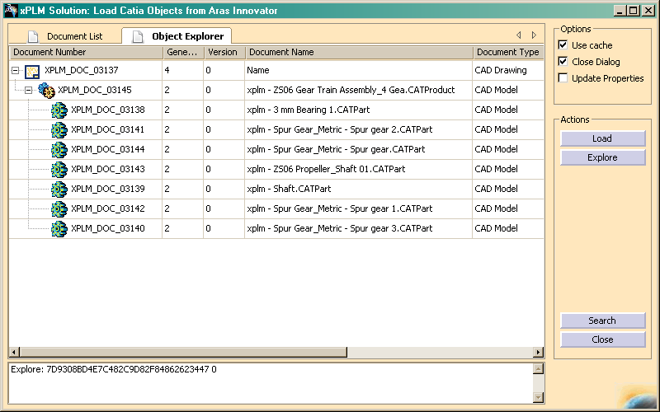
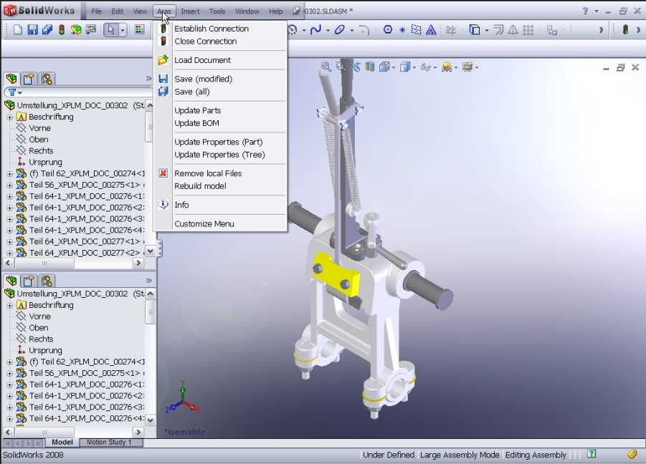
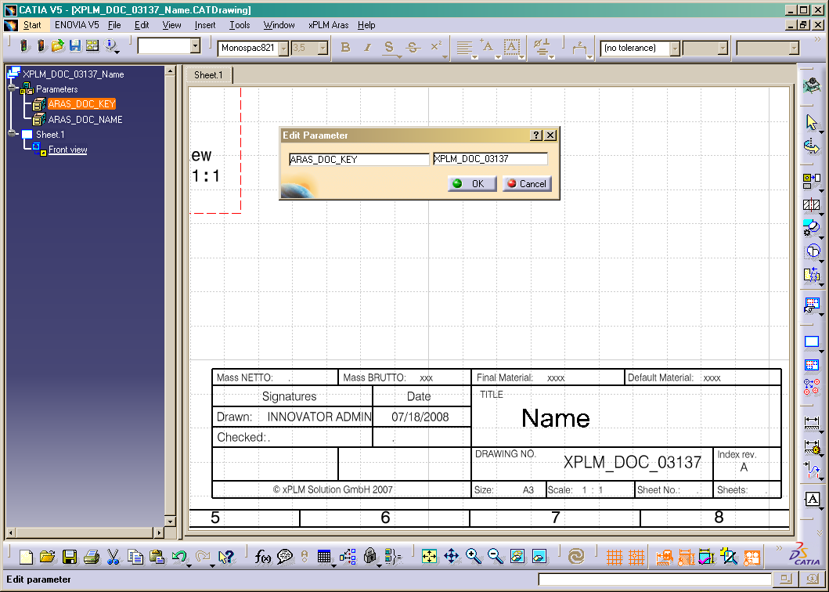
CAD Integration
xPLM Connector
CAD System
Integration Capabilities
Document & File Management
Management of Complex CAD Structures
Items & BOM, Based on CAD design
Workflow and Release Management
Checkin and Checkout from CAD
Take and Release Ownership
Management of Multiple Revisions
Save Preview Before Final Saving
Search and Load from PDM
Bidirectional Exchange of Properties
Update PLM-Attributes from CAD
File Conversion (e.g. Viewables)
Slide <number>

